Slide 1
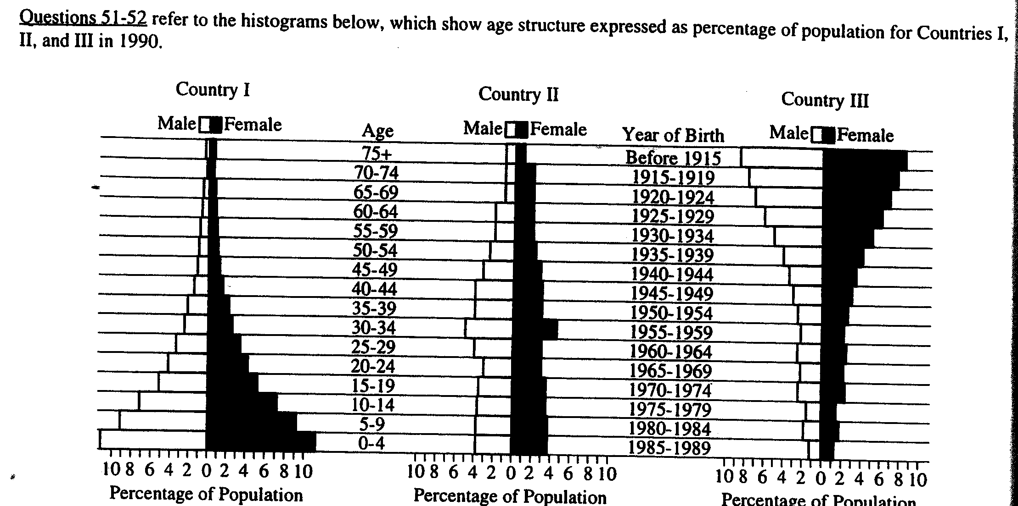
Population Math problems
Q: Which country is undergoing rapid population growth?
b. Growing
c. Declining
d. None of the above

Slide 2
Calculating Population Growth Rate and Doubling Time
Solutions

Slide 3
Global pop Growth Rate: Sample 1
Worldwide, there were 20 births and 8 deaths per 1,000 in 2009. Calculate the growth rate of the world in 2009.
(CBR-CDR)
10
Population growth rate –
Population growth rate – (20 - 8)
10
Population growth rate – (12)
10
= 1.2%

Slide 4
Growth Rate of Nation: Sample Problem 2
The tiny country of Fremont has a population of 100,000 people. In 2009, there were 2,000 births, 500 deaths, 200 emigrants, and 100 immigrants. What is the population growth rate (r) for 2009?
Growth Rate for a
nation or region=
(CBR + I) - (CDR + E)
10
Growth Rate for a
nation or region=
(20 + 1) - (5 + 2)
10
Growth Rate for a
nation or region=
(21) - (7)
10
14
10
=
= 1.4%

Slide 5
Rule of 70: Sample Problem
The small town of West Fremont has a population of 50,000. If the growth rate of West Fremont is 2%, then how long will it take for the population of West Fremont to double?
70
r
Doubling time (in years)
=
Doubling time (in years)
70
2
=
Doubling time (in years)
= 35 years

Slide 6
1. North Fremont’s population growth rate is 5%. What is the doubling time for North Fremont?
70
r
Doubling time (in years)
=
Doubling time (in years)
70
5
=
Doubling time (in years)
= 14 years

Slide 7
2a. New Fremont had a birthrate of 12 per 1,000 in 2010 and a death rate of 9 per 1,000.
(CBR-CDR)
10
Population growth rate –
Population growth rate –
(12-9)
10
Population growth rate –
3_
10
= 0.3%

Slide 8
2b. If the current population of New Fremont is 150,000, how long will it take the country to double its population using the current growth rate? (Round to the nearest whole number.)
70
r
Doubling time (in years)
=
Doubling time (in years)
70
.3
=
Doubling time (in years)
= 233 years

Slide 9
3a. Central Fremont has a crude birth rate of 24 per 1,000 and a crude death rate of 8 per 1,000. What is the natural annual increase of Central Fremont?
(CBR-CDR)
Natural rate of increase–
Natural rate of increase–
(24-8) = 16
16
10 =
Population growth rate –
1.6

Slide 10
3b. At this rate of increase, how long will it take Central Fremont’s population of 35,000 to double? (Round to the nearest whole number.)
70
r
Doubling time (in years)
=
Doubling time (in years)
70
1.6
=
Doubling time (in years)
= 44 years

Slide 11
4. In 2010, the crude birth rate in Lower Fremont was 25 and the crude death rate was 11. If the population was 15,000 in 2010, and the population growth rate remains constant, when will the population reach 30,000?
1
* How many times will the population double?
(CBR-CDR)
10
(25-11)
10
14
10
Pop growth rate –
=
=
=
1.4%
70
r
70
1.4
Doubling time (in years)
=
=
= 50 Years
2010 + 50 years = 2060

Slide 12
5. In 2010, East Fremont had a population of 10 million people, a birth rate of 7.2%, and a death rate of 2.2%. If the birth and death rates remain constant, in what year will the population will be close to 40 million people?
* How many times did the population double?
2
Pop growth rate –
(CBR-CDR)
(7.2% – 2.2%)
=
= 5%
*Birth and death rates already in %, so do not divide by 10!
70
r
70
5
Doubling time (in years)
=
=
= 14 Years
14 years 2 Doubles
1 Double
X
= 28 years or the year 2038

Slide 13
6. In 2010, the population of Fremontville was 6 million and growing at a rate of 1.4% / year. If the rate of population growth remains constant, in what year will the population reach 24 million people?
* How many times did the population double?
2
70
r
Doubling time (in years)
=
70
1.4
=
= 50 Years
50 years 2 Doubles
1 Double
X
= 100 years or the year 2110

